Slide 1

ElderGuard
Lim Jun Ming - A0231523U
Mediana - A0231458E
Yeong Wee Ping - A0231533R

Slide 2
01
OBJECTIVES & SYSTEM OVERVIEW

Slide 3
Objectives
Building an application that can help to protect vulnerable elderly from being scammed or cheated.
Our application detects text messages that may be fraudulent in nature, for examples spam messages, fraudulent messages that contains malicious or phishing URLs.

Slide 4
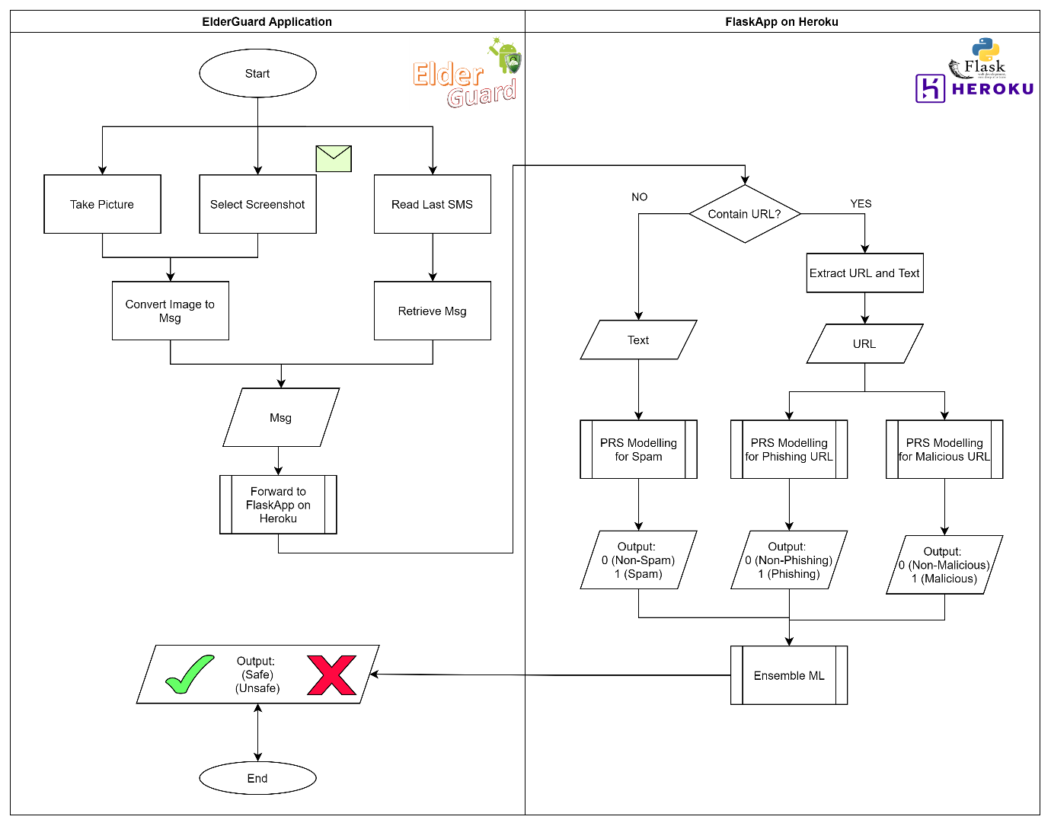
System Overview

Slide 5
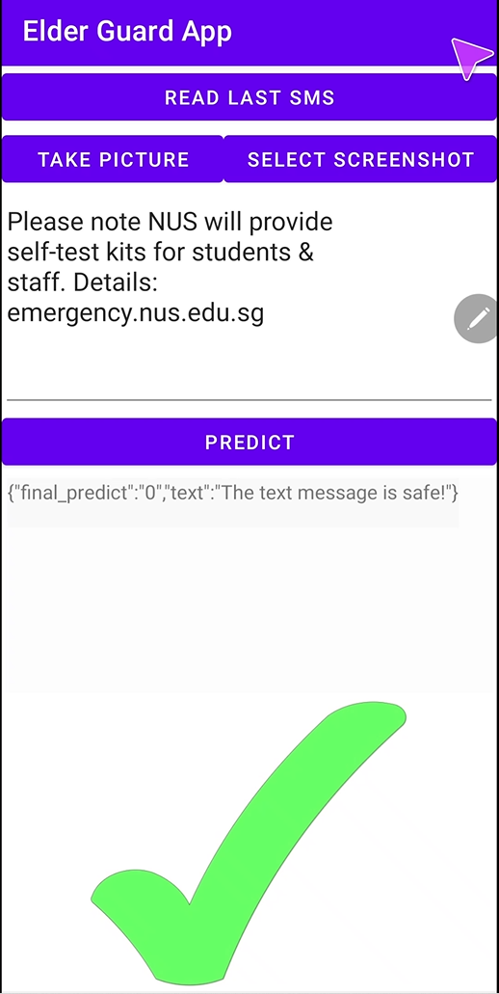
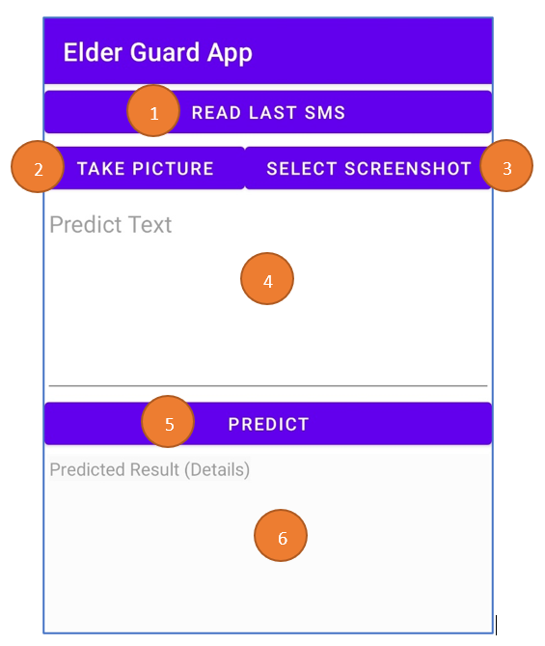
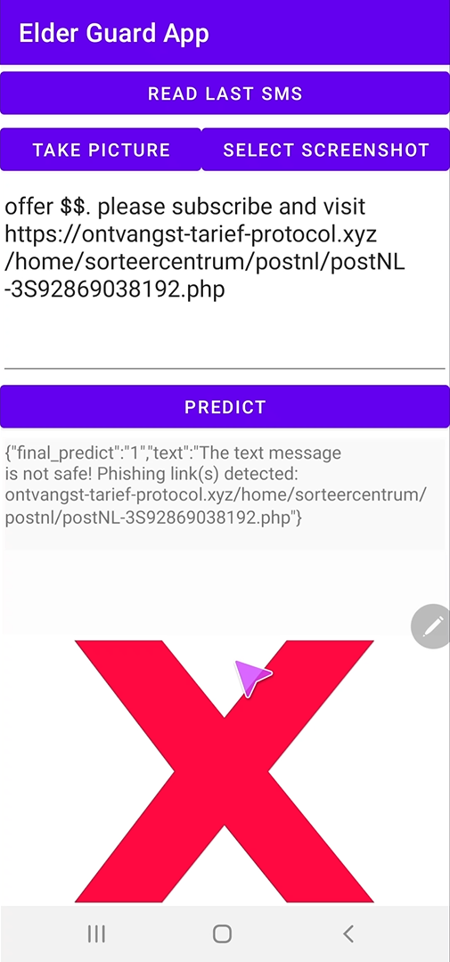
ElderGuard – Android App (Front End)

Slide 6
ElderGuard – Android App (Front End)
Take Picture
Select Screenshot
Read Last SMS
01
02
03
04
Predict
Take picture and convert into text for prediction
Select screenshot from Gallery and convert into text for prediction
Retrieve the last received message for prediction
Forward the text to backend (Heroku) for prediction

Slide 7
Three Modules in Heroku (Back End)
01
02
03
Malicious URL Module
Spam Text Module
Phishing URL Module

Slide 8
02
SPAM TEXT MODULE

Slide 9
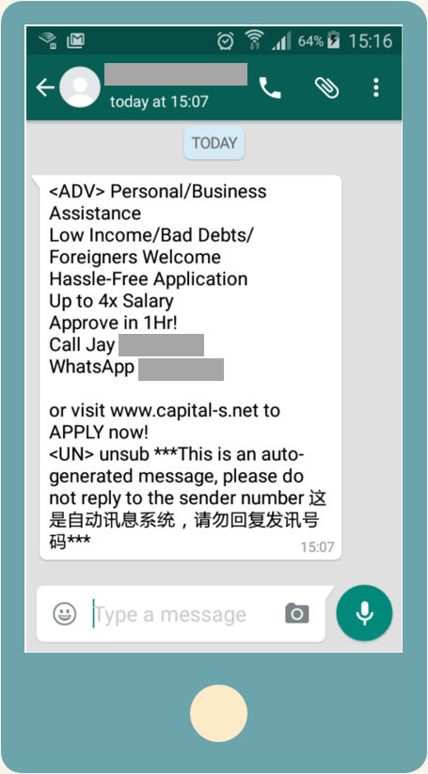
Spam Text – A Classic Machine Learning Problem
Many research and literature have utilized various effective machine learning algorithms in predicting spam text
1
Supervised Machine Learning
Naive Bayes
Support Vector Machine (SVM)
Random Forest
K-Nearest Neighbors (KNN)
Some Challenges!
01
Insufficient Labelled Dataset
Costly effort to collect and label text messages
02
Imbalanced Dataset
Minority spam class text message in dataset
2
Deep Learning
Convolution Neural Network (CNN)
Recurrent Neural Network (RNN)
Long Short-Term Memory (LSTM)
SPAM!
03
Loosely Used Language
“Singlish” are widely used in text messages
Notes:
Marketing Spam on WhatsApp Is Not Very 2016 https://medium.com/@liva/spamming-on-whatsapp-to-market-stuff-is-not-very-2016-72c32783a55

Slide 10
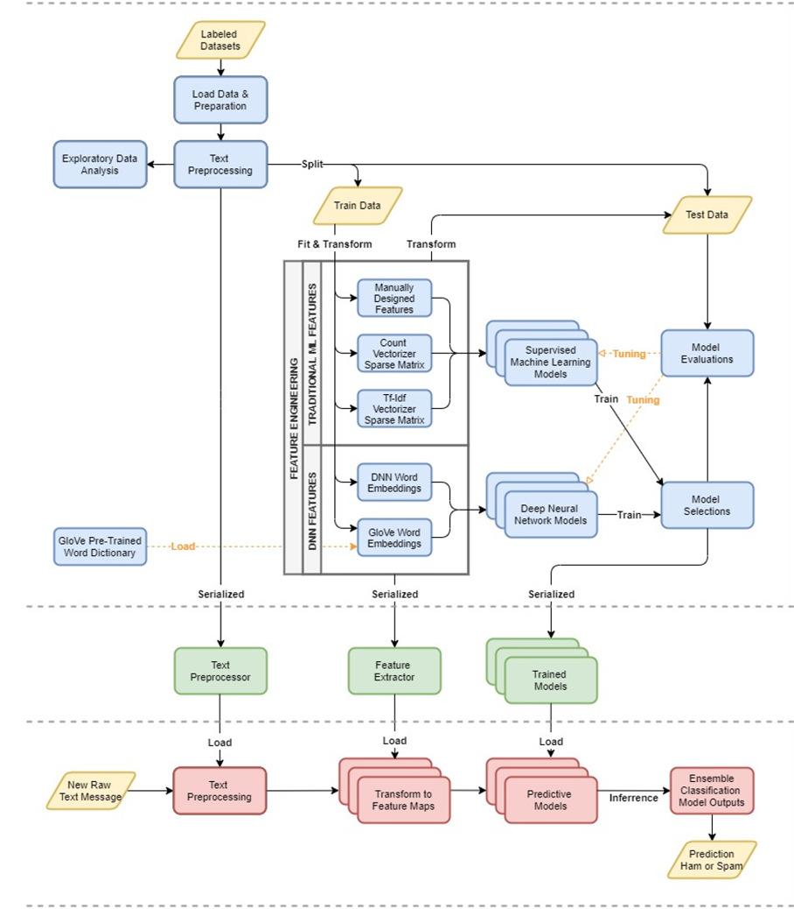
Spam Text – Module Pipeline Design
Model Training & Selection
Feature Engineering & Extraction
Machine Learning Models Training
Hyperparameter Tuning
Model Evaluation
Model Selection
Deployment & Serialization
Inference

Slide 11
Spam Text – Dataset
Dataset | Source | Class |  | Total
 |  | Ham | Spam
SMS Spam Collection Dataset | UCI Machine Learning Repository | 4,825 | 747 | 5,572
SMS Dataset | Kaggle Open Dataset | 77 | 107 | 184
Manually Collected Spam SMS | Personal Mobile Phone SMS Records | 0 | 81 | 81
Aggregated Dataset |  | 4,902 | 935 | 5,837
All dataset used for training the spam text prediction models are all labelled dataset that are either ham or spam.
Part of the SMS corpus used in the SMS Spam Collection Dataset (UCI Machine Learning Repository) is based on the NUS SMS Corpus, which includes common loosely used language in Singapore.
For manually collected spam SMS, only SMS which are most certainly a spam text message are selected and annotated to be included in the dataset.
This is an attempt to address the issues on insufficient annotated datasets and imbalance datasets.
Notes:
University of California Irvine (UCI) Machine Learning Repository SMS Spam Collection Data Set https://archive.ics.uci.edu/ml/datasets/sms+spam+collection
Uddeshya Singh Kaggle SMS Dataset https://www.kaggle.com/uds5501/sms-dataset

Slide 12
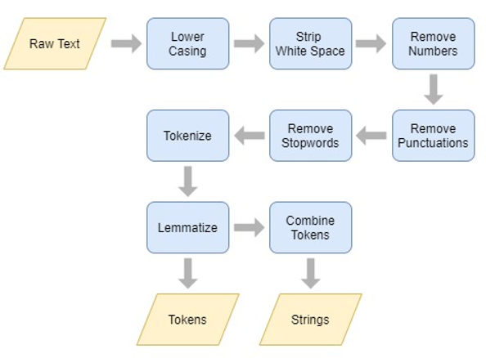
Spam Text – Text Pre-processing
Before we perform any feature extraction on the SMS dataset, we need to apply some text preprocessing.
2 Types of Outputs Saved:
List of Tokens
Ex: [“love”, “book”, “today”, “happy”]
Tokens in Combined String
Ex: “love book today happy”

Slide 13
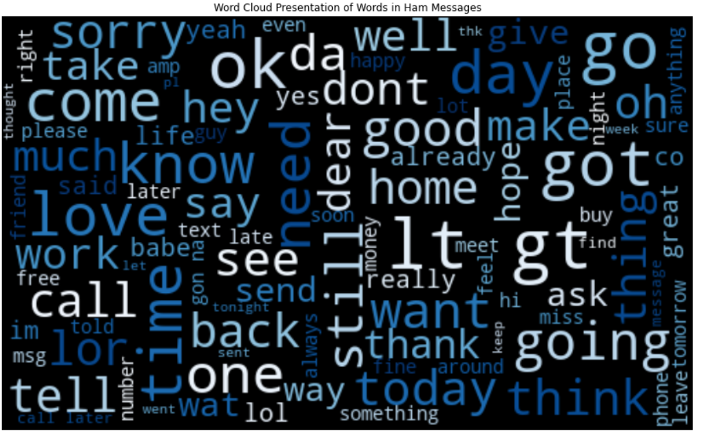
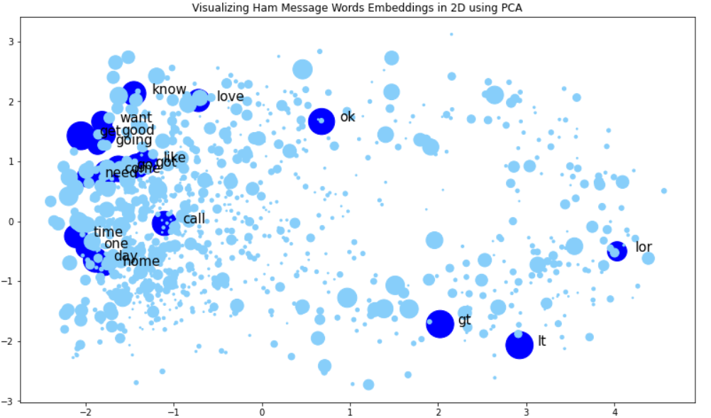
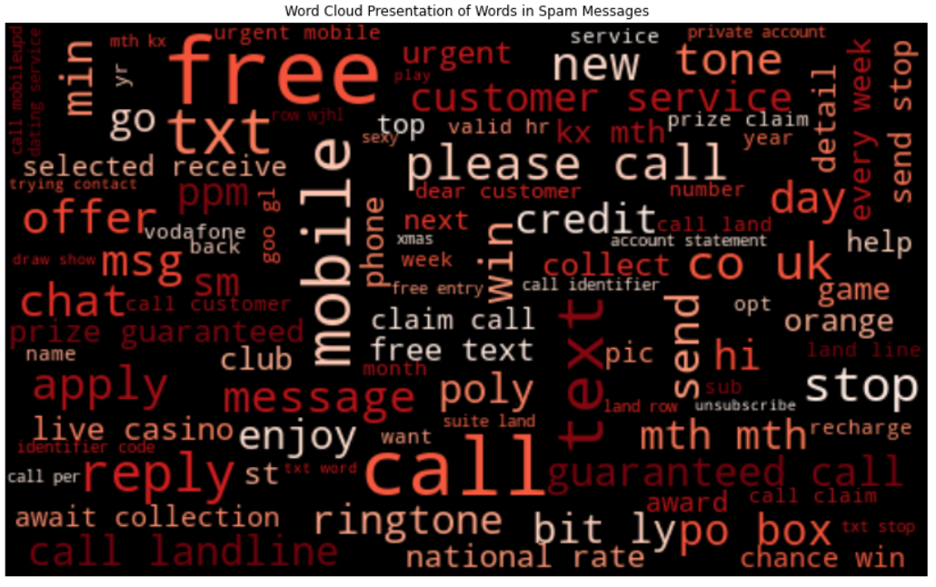
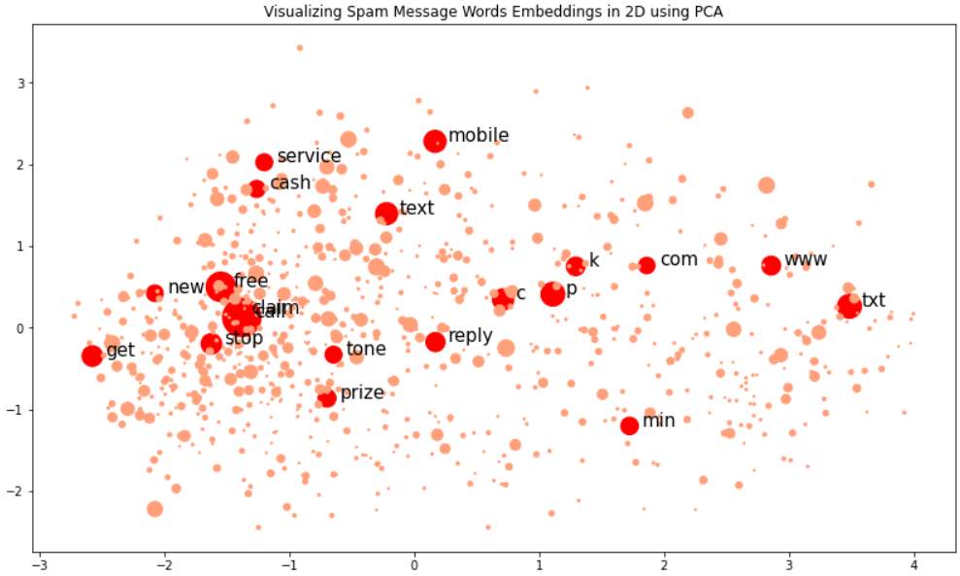
Spam Text – Exploratory Data Analysis
Common Words
Word Embeddings Visualization
The set of top common words in ham messages is different from spam messages
Common ham words are closer to each other in word embedding visualization
Ham
Spam
Common spam words are more spread out across the word embedding visualization

Slide 14
Spam Text – Feature Extraction
Various feature extraction methods are explored and used for fitting different machine learning models.
Manually Design Features
Count of mathematical symbols
Count of special symbols
Fully uppercased words
Occurrence of Top 20 spam words
Occurrence of SMS or phone number
Length of Tokens
Bag-Of-Words (BoW)
Count Vectorizer
Tf-Idf Vectorizer
Word Embeddings
Pre-trained word embeddings (GloVe)
Word embeddings trained from data
Traditional Machine Learning Model
Naïve Bayes
Logistic Regression
Random Forest
Support Vector Machine (SVM)
AdaBoost
K-Nearest Neighbor (KNN)
Deep Neural Network
Based Model
CNN
LSTM
CNN-LSTM
Notes:
Jeffrey Pennington, Richard Socher, Christopher D. Manning Global Vectors for Word Representation (GloVe) https://nlp.stanford.edu/projects/glove/
Appendix – Dimension of Feature Representation
Appendix – Hyperparameters and Number of Parameters

Slide 15
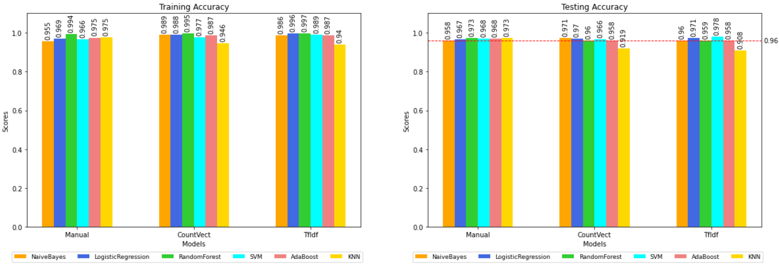
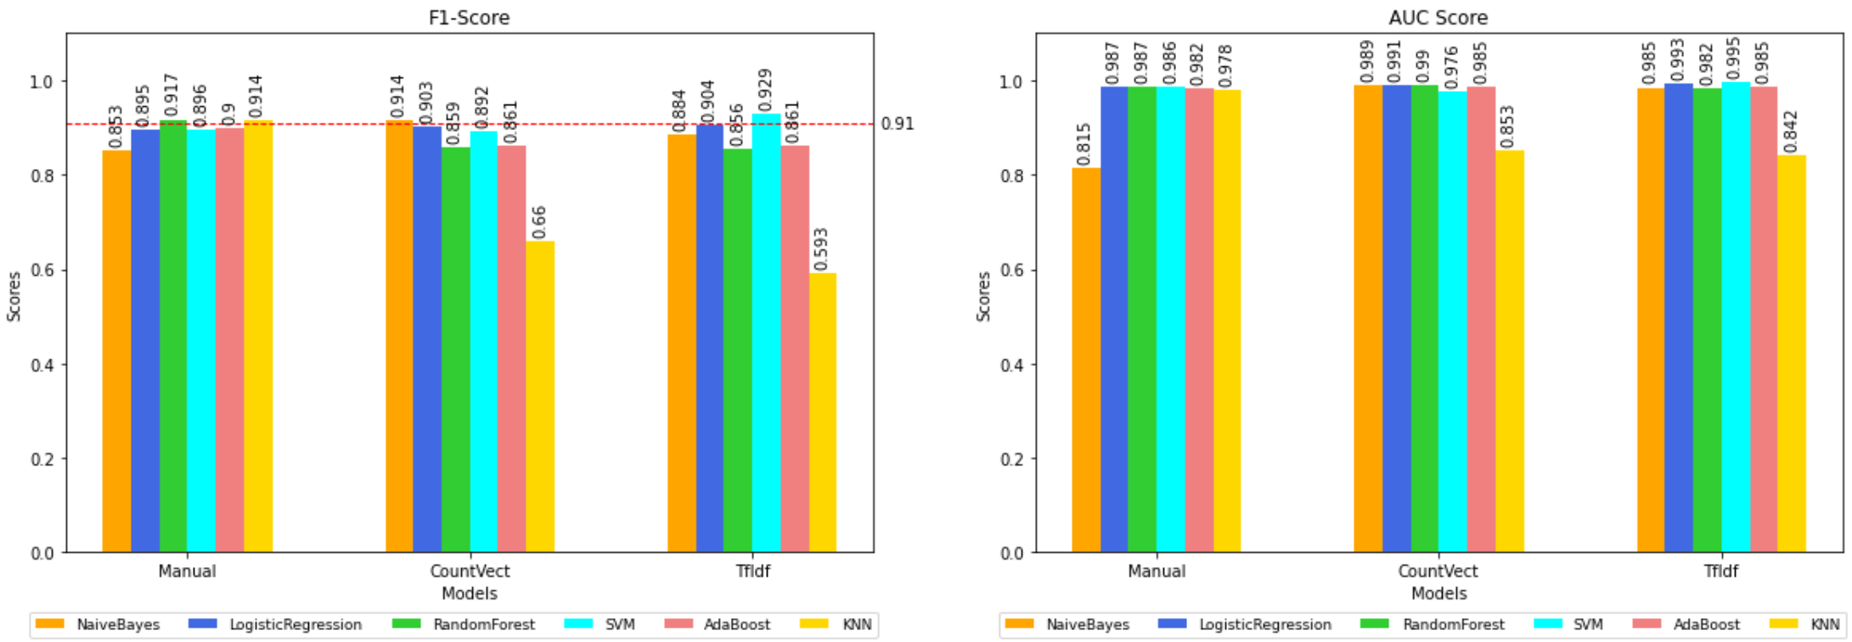
Spam Text – Tradional ML Model Evaluation
Observations
Most of models are performing well with test accuracy of at least 90%
For manually designed features, Random Forest and KNN performed the best with test accuracy more than 97% and F1-score more than 91%.
For Count Vectorization feature, Naïve Bayes performed the best with test accuracy more than 97% and F1-score more than 91%.
For Tf-idf Vectorization feature, SVM perform the best with test accuracy close to 98% and F1-score close to 93%.
AdaBoost is performing the worst using the 2 BoW feature extractions.
Notes:
Appendix – Traditional ML Model Hyperparameters Evaluated

Slide 16
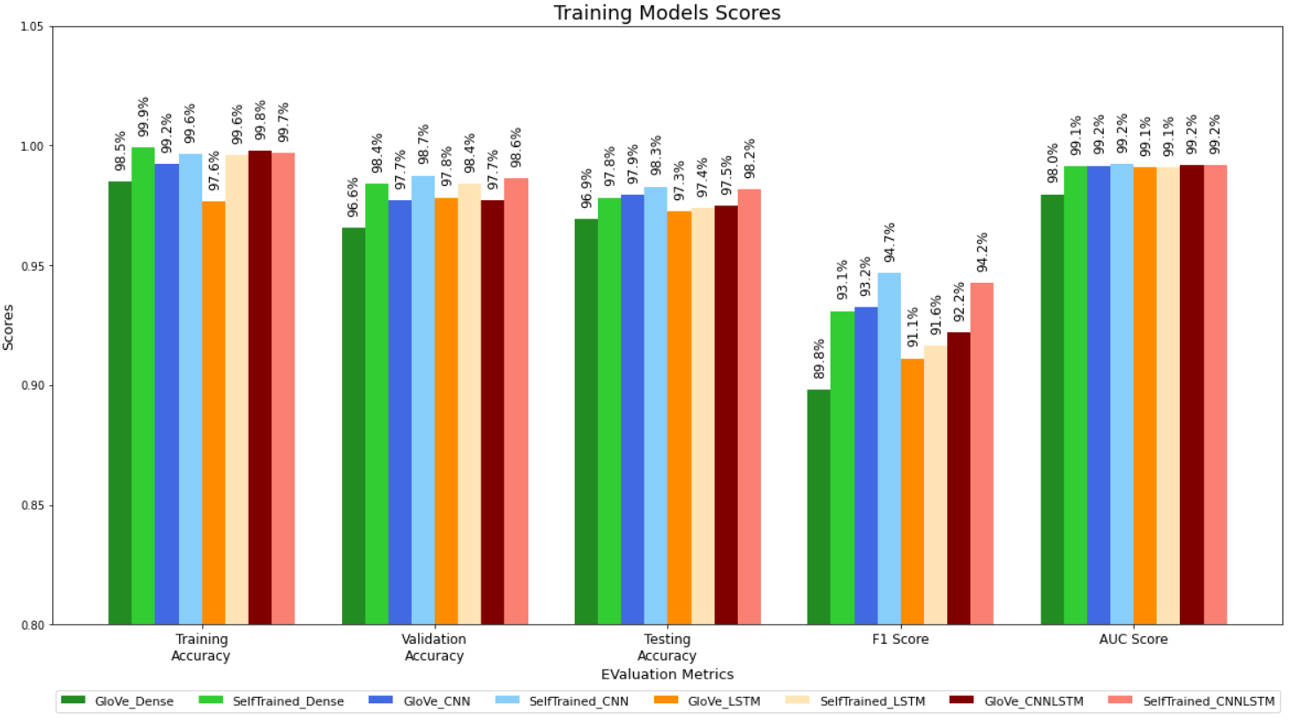
Spam Text – DNN Based Model Evaluation
Reducing Overfitting
Various model architecture are test and tuned to reduce the overfitting.
Dropout layers are used and after Convolutional Layers or Dense Layers
L2 Regularization are used for various Convolutional Layers and/or Dense Layers
Batch size epoch training ranges around 10 to 50
Observations
Most of the DNN based models are performing slightly better than traditional ML models with test accuracy at around 98% and highest F1-score close to 95%.
All models that uses word embeddings trained from data are performing slightly better than models that use pre-trained GloVe word embeddings.
The CNN and CNN-LSTM model with word embeddings trained from data are the best performing model with test accuracy at 98.2% and F1-score of more than 94%

Slide 17
Spam Text – Model Selection & Deployment
To select a model for deployment, we look at the following key criteria for consideration
Consideration | Description
Model Evaluation | To select models with best performance based on the training results.
Type of Features | To cover all types of features as different features may capture different important information that may be useful in spam text classifications
Light Weight | Models with less weights or parameters trained. This ensure that file size of the serialized models is small for deployment.
Fast Inference | The inference should be fast enough to ensure that the app can run smoothly
Final Models Selected for Deployment
Model | Type | Features
Naïve Bayes | Traditional ML | BoW – Count Vectorizer
SVM | Traditional ML | BoW – TfIdf Vectorizer
KNN | Traditional ML | Manually Designed Features
CNN | DNN Based | Word Embeddings Trained from Dataset
Based on light weight models with accuracy at least 96% and F1-score at least 91%
Based on best performing and low number of parameters DNN based model – CNN with word embeddings trained from Dataset

Slide 18
03
PHISHING URL MODULE

Slide 19
Grown 65%
Phishing Attempt (in 2019)
30% get opened
Phishing messages
According to Phishing and Email Fraud Statistics 2019 conducted by ReTruster

Slide 20
$ 764,000 lost in 2021 September
e-Commerce Phishing Scams in Singapore
https://www.straitstimes.com/singapore/courts-crime/at-least-764000-lost-in-september-to-e-commerce-phishing-scams-in-spore

Slide 21
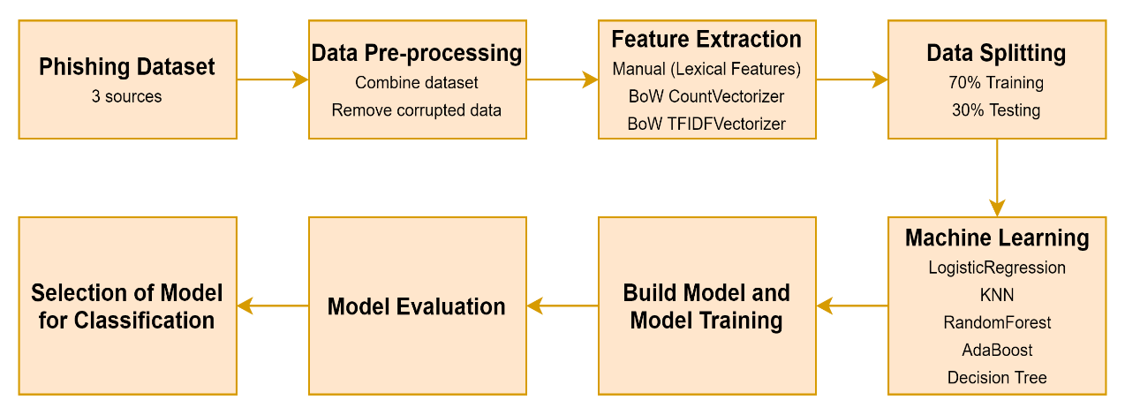
Module System Pipeline

Slide 22
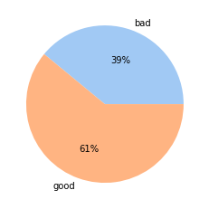
Phishing Dataset
01
02
03
Kaggle – Phishing Site URLs
OpenPhish
https://openphish.com/feed.txt
Kaggle – Malicious URLs (Phishing)
https://www.kaggle.com/sid321axn/malicious-urls-dataset
Three datasets are combined to ensure no imbalanced datasets issue, and pre-processed to remove duplicates data
61% of Good URL and 39% of Phishing URL
https://www.kaggle.com/taruntiwarihp/phishing-site-urls

Slide 23
3 Ways - Feature Extraction
24 Lexical Features (Manual Extraction)
URL Components | Lexical Features | Variable Name
URL | Total URL Length | tot_url_length
Netloc | NetLoc Length | netloc_length
Path | Path Length | path_length
First Directory | First Directory Length | fd_length
Suffix | Suffix Length | suffix_length
Subdomains | Number of Subdomains | num_subdomains
Domain | Count of "-" in Domain | domaindesk
URL | Count of "-" in URL | urldesk
Path | Count of "-" in Path | pathdesk
Domain | Count of "_" in Domain | domain_
URL | Count of "_" | countunderscore
Path | Count of "_" in Path | path_
URL | Count of directory | count_dir
Path | Count of “.” in Path | path_fsdot
URL | Count of “@” | countat
URL | Count of “?” | countquest
URL | Count of “%” | countpercent
URL | Count of “.” | countdot
URL | Count of “=” | counteq
Path | Count of HTTP in Path | count_http_inpath
Path | Count of HTTPS in Path | count_https_inpath
Path | Count of WWW in Path | count_www_inpath
URL | Count of digits | countdigits
URL | Count of letters | countletters
Manual - Lexical Features
Using 24 different lexical features, as per table beside
Bag-Of-Words (CountVectorizer)
Convert text data into matrix of token counts, with length of vocabulary 314826
Bag-of-Words (TF-IDF)
Convert the text data to matrix of TF-IDF features, with length of vocabulary 314826
Focuses only on the frequency of words
Provides the importance of words

Slide 24
Supervised Machine Learning (Training)
Machine Learning Techniques | Features | Hyperparameters
Logistic Regression | Manual Lexical, CountVectorizer, TFIDFVectorizer | Regularization Strength: {3, 2, 1, 0.3, 0.1, 0.03, 0.01, 0.003, 0.001}
K-Nearest Neighbour | Manual Lexical, CountVectorizer, TFIDFVectorizer | N_Neighbours: {3, 5, 7}
Decision Tree | Manual Lexical, CountVectorizer, TFIDFVectorizer | Via GridSearch to search for best score and parameters.riterion: {gini, entropy} Max_depth: {2 to 10} Min_samples_split: {2 to 100}
Random Forest | Manual Lexical, CountVectorizer, TFIDFVectorizer | N_trees: {3, 5, 10, 25, 50} Tree_depth: {4, 10, 20, 50}
AdaBoost | Manual Lexical, CountVectorizer, TFIDFVectorizer | N_trees: {25, 50, 100} Tree_depth: {1,2,4,10}
Naïve Bayes | CountVectorizer TFIDFVectorizer | alpha=1.0
Datasets are split into 2 subsets, 70% for training and 30% for testing.
Machine learning algorithm and hyperparameters used in the training are shown in the table.
Most of the models performed around 70%-92% for training accuracy, 70%-86% for testing accuracy, and 80%-93% of AUC score.

Slide 25
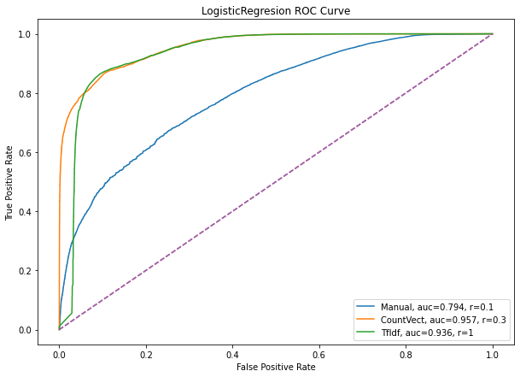
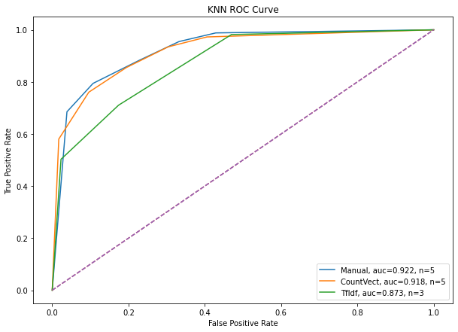
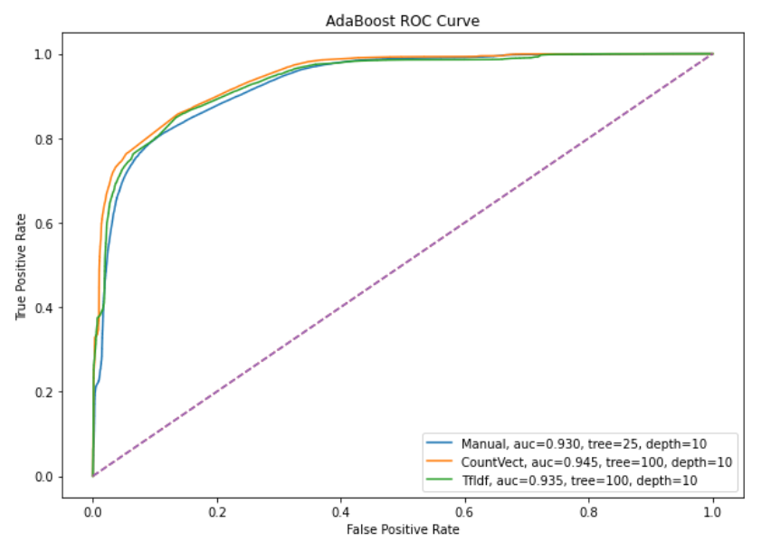
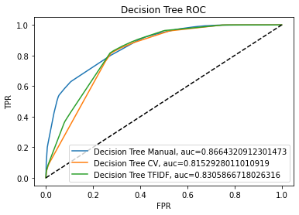
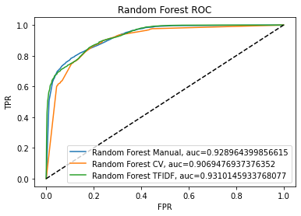
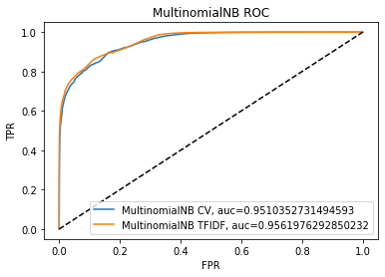
Supervised Machine Learning (Evaluation)
Notes:
Marketing Spam on WhatsApp Is Not Very 2016 https://medium.com/@liva/spamming-on-whatsapp-to-market-stuff-is-not-very-2016-72c32783a55

Slide 26
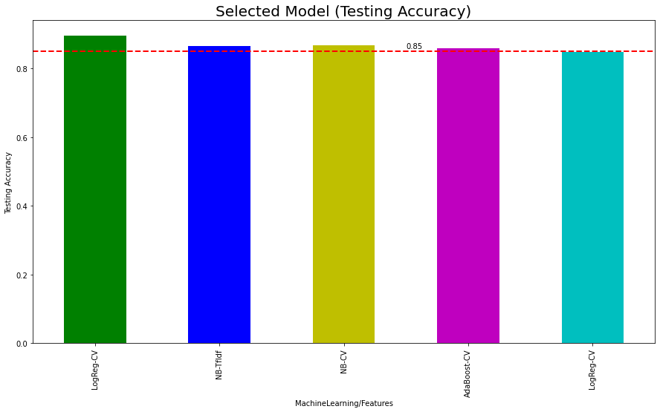
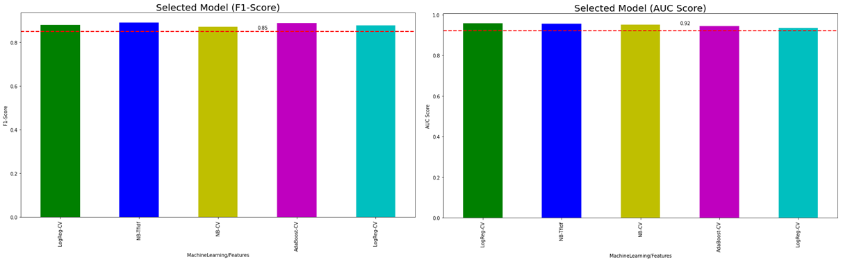
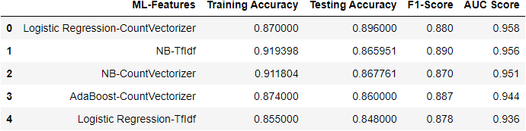
Model Comparison and Selection Testing Accuracy, F1-Score and AUC Score
Model with at least 85% of testing accuracy, 85% of F1-Score, and 92% of AUC-score, are selected for final deployment.
All the five selected model are combined using ensembled with weighted voting to get the final prediction

Slide 27
04
MALICIOUS URL MODULE

Slide 28
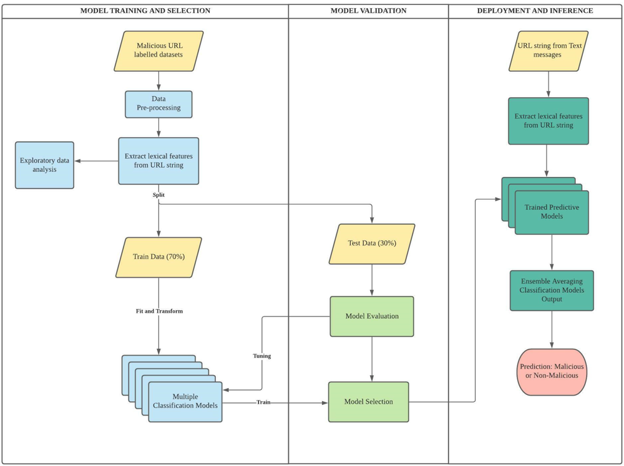
Module Workflow
Start with doing data pre-processing on labelled datasets
Extract lexical features from the URL string
Split 70% train and 30% test
Employ multiple traditional Machine Learning models
Conduct evaluations to select the best preforming models for our Malicious URL classification task in deployment

Slide 29
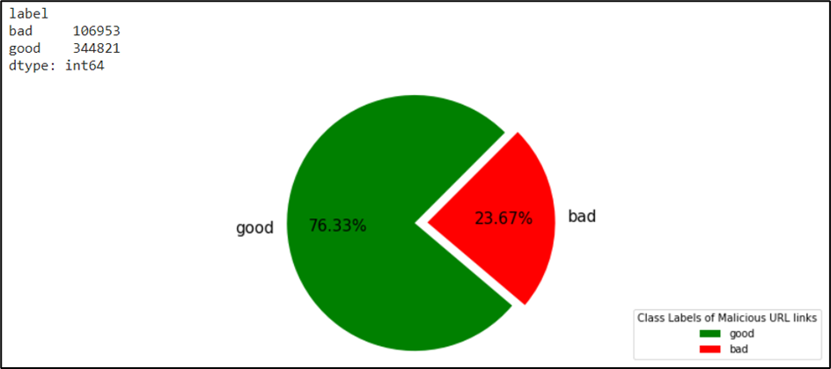
DATASETS
01
02
Kaggle:
Kaggle:
https://www.kaggle.com/antonyj453/urldataset/
https://www.kaggle.com/sid321axn/malicious-urls-dataset/

Slide 30
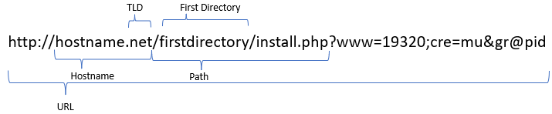
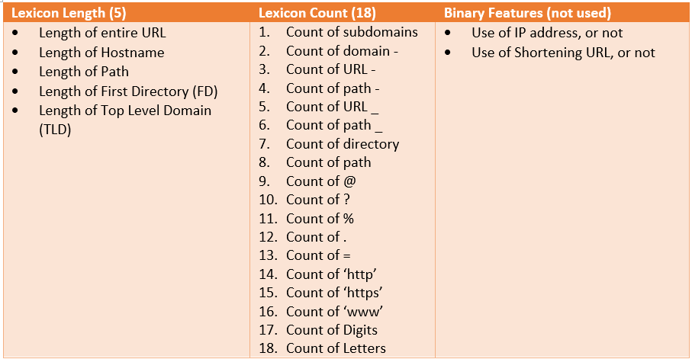
FEATURES EXTRACTION
In order to build a light-weight classification system that can produce fast prediction results, only lexical features from the URL are extracted as feature maps to train our models
Total of 23 different lexical features will be used
During model tuning and validation, it was discovered that the binary features did not have any significant impact on any of the model performance, hence will be discarded

Slide 31
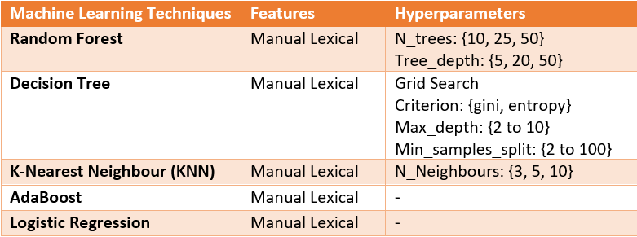
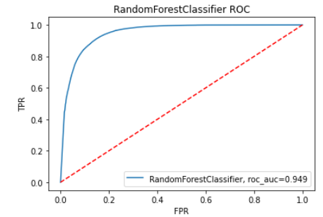
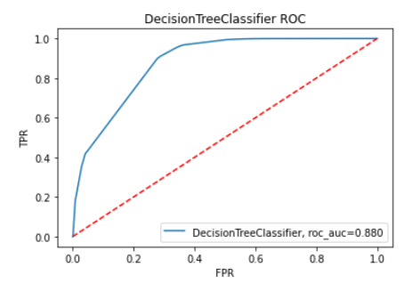
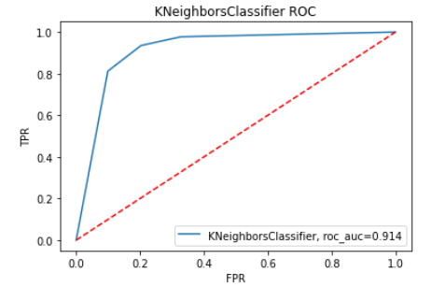
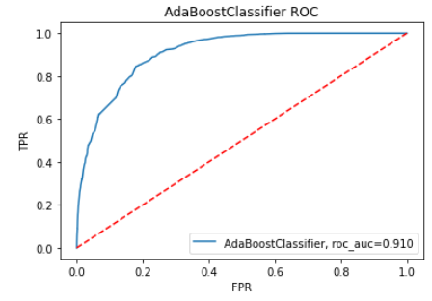
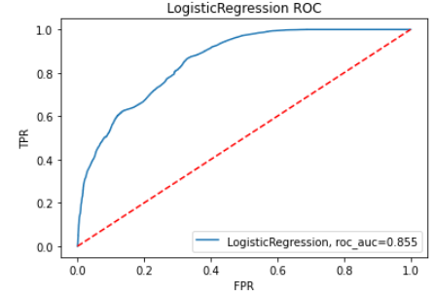
MODEL TRAINING AND EVALUATION
5 different Machine Learning models were used in this training phrase
01
02
03
04
05

Slide 32
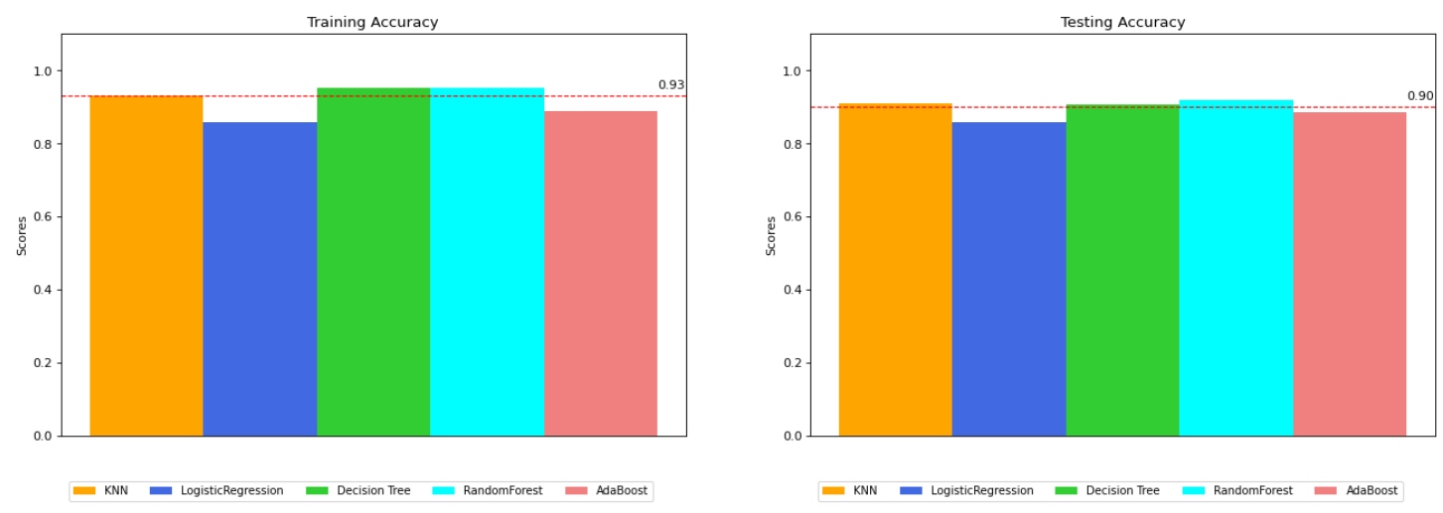
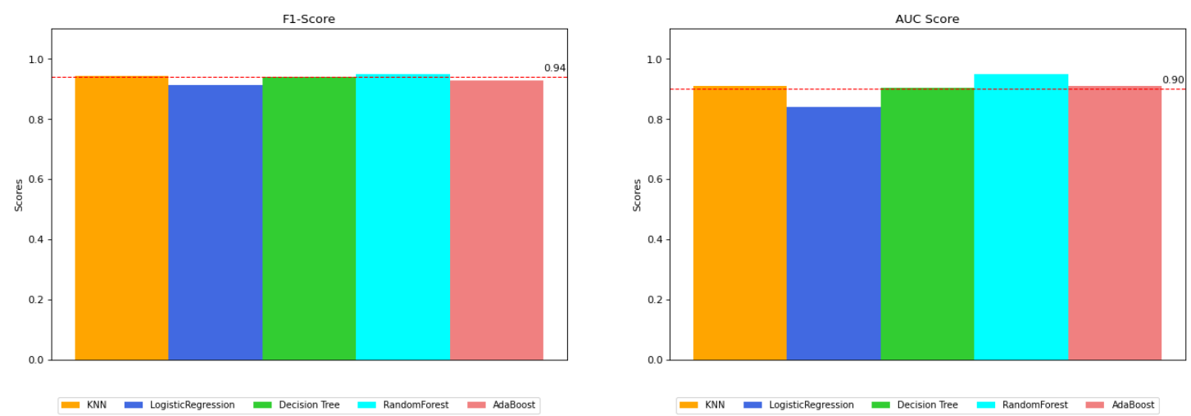
MODEL TRAINING AND EVALUATION
Besides the training and testing accuracy given the class imbalance, F1 score is also important
From these charts, it can be seen that
Random Forest
Decision Trees
KNN
gave consistent higher performance than the rest of the models

Slide 33
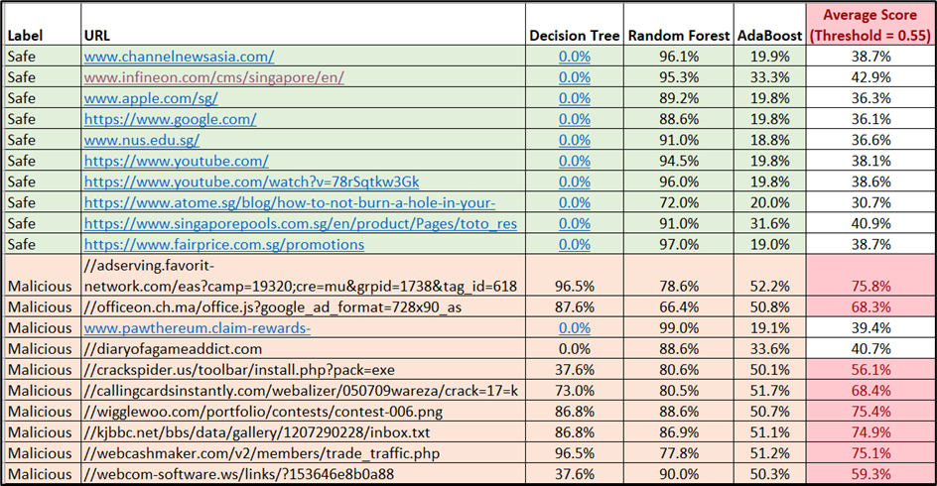
MODEL SELECTION
To further simulate a real case, 10 known safe and 10 known malicious URL sites are fed into our Malicious URL detection models
However, one main observation that KNN did not peform well at all
Instead AdaBoost proved to the next best which was used to replace KNN
Finally, an ensemble averaging approach using simple average was adopted using Decision Trees, Random Forest and AdaBoost

Slide 34
05
SUMMARY

Slide 35
Conclusion and Future Improvement
We have proposed a machine learning driven application that provides the capability of predicting the safety of text messages content through an Android application with predictive engine deployment and hosted on Heroku.
Three types of malicious content in text messages are identified and addressed in our system:
01
02
03
Spam Text
Phishing URL
Malicious URL
Limitations & Future Improvements:
LIMITATIONS | IMPROVEMENTS
Trend changes in language and style used in text messages may cause model to misclassify | Explore more advanced algorithms such as transformer-based NLP deep learning models for classification task
Imbalance dataset that may affect performance and evaluation of models | To collect more data or simulate more data for the minority class, which may be a costly in terms of time and resources
Current system only applicable to text message in English language | To consider separate spam text module that handles other languages such as Chinese.
Current system requires user to input the text message manually for prediction | To build in a functionality that automatically retrieve incoming text messages for prediction

Slide 36


Thanks!
Prepared By:
Lim Jun Ming | A0231523U
Mediana | A0231458E
Yong Wee Ping | A0231533R

Slide 37
Appendix

Slide 38
Spam Text Module – Dimension of Feature Representation
Feature Engineering Method | Model Type | Input Dataset Type | Feature Dimension (each data point) | Word Vocabulary Size
Manually Designed Features | Traditional ML | Raw full Text, Token-based | 6 | -
BoW – Count Vectorizer | Traditional ML | String-based | 6,390 | 6,389
BoW – Tf-Idf Vectorizer | Traditional ML | String-based | 6,390 | 6,389
Word Embeddings trained from Data | DNN Based | String-based | 30 | 6,389
Pre-trained Word Embeddings GloVe | DNN Based | Token-based | 30x50 | 5,181

Slide 39
Spam Text Module – Hyperparameters and Number of Parameters
Traditional ML Models
Model | Feature Input Types | Hyperparameters Experimented
Naïve Bayes | Manually Designed Features BoW – Count Vectorizer BoW – Tf-Idf Vectorizer | -
Logistic Regression |  | Regularization Strength - 3, 2, 1, 0.3, 0.1, 0.03, 0.01, 0.003, 0.001
Random Forest |  | Number of Trees - 3, 5, 10, 25, 50 Number of Features - 1, 2, 4, 10, 20, 50
SVM |  | Gamma - 0.0001, 0.0003, 0.001, 0.003, 0.01, 0.03, 0.1, 0.3, 1, 3
AdaBoost |  | Number of Trees - 25, 50, 100 Tree Depth - 1, 2, 4, 10
KNN |  | Number of Neighbour - 3, 5, 7, 9, 11
DNN Based Models
Model | Word-Embeddings | Number of Parameters | Loss Function | Optimizer (Learning Rate, LR)
Dense | GloVe | 844,545 | Binary cross-entropy | Adam (LR = 0.00015)
CNN | GloVe | 70,641 | Binary cross-entropy | Adam (LR = 0.0002)
LSTM | GloVe | 104,297 | Binary cross-entropy | Adam (LR = 0.0001)
CNN-LSTM | GloVe | 118,225 | Binary cross-entropy | Adam (LR = 0.0001)
Dense | Trained From Data | 725,319 | Binary cross-entropy | Adam (LR = 0.0002)
CNN | Trained From Data | 359,435 | Binary cross-entropy | Adam (LR = 0.00015)
LSTM | Trained From Data | 423,355 | Binary cross-entropy | Adam (LR = 0.00004)
CNN-LSTM | Trained From Data | 407,851 | Binary cross-entropy | Adam (LR = 0.00004)

Slide 40
Spam Text Module – Traditional ML Model Hyperparameters Evaluated

Slide 41
Phishing Module Dataset Distributions

Slide 42
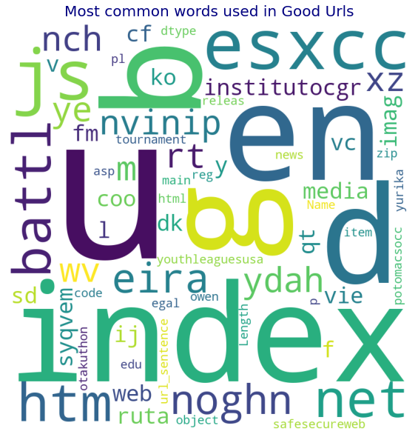
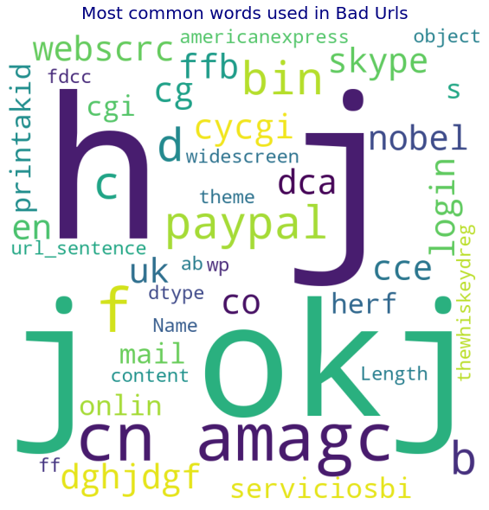
Phishing Module World Clouds in Good and Bad URLs

Slide 43
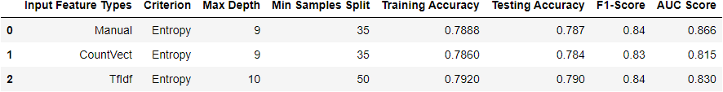
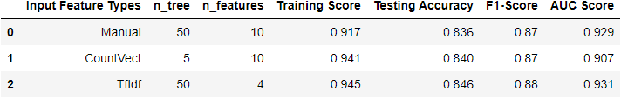
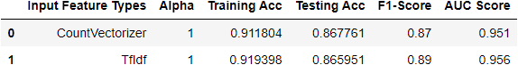
Phishing Module ML Model Evaluation Result (I)
Decision Tree
Random Forest
Naïve Bayes

Slide 44
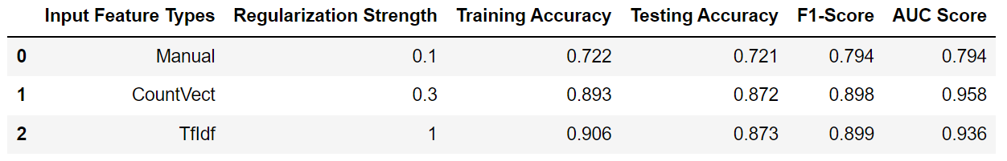
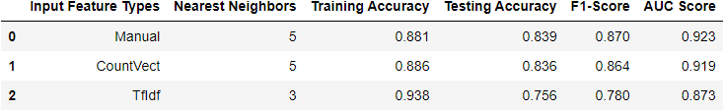
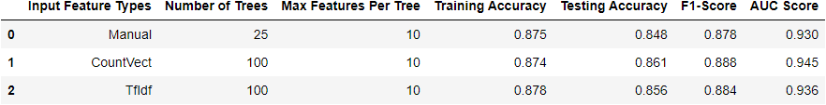
Phishing Module ML Model Evaluation Result (II)
Logistic Regression
KNN
AdaBoost

